Slide 1

Corporate action Sentiment analysis and its impact on underlying equity performance
For Professor Robert Rokey, Class,IS-7092
Advised By, Professor Sachin Modi
Presented By, Dwijesh Bharadwaj Kuppahalli Krishnamurthy
University of Cincinnati, Lindner College of Business
Information Systems, Masters

Slide 2










Overview
Introduction
Extracting the Tweets
Sentiment Analysis with Groq LLM
Sentiment Score Analysis
Intensity Score Analysis
Emotion Classification and Analysis
AI Emphasis Analysis
Analytics
Conclusion
References
Data Collection
Daily Returns Yahoo API
Data Analysis
Exploratory Analytics
Prediction &Classification Models

Slide 3
Introduction
Lay Down the Process for Sentiment Analysis of Tweets Using a Large Language Model
Tweets text extraction from “X” API
Leverage Large Language Models to analyze the sentiments in CEO’s Tweets
Get the Daily returns of Publicly traded companies
Assess the predictive power of these sentiments on financial performance.
Identify patterns indicating the impact of CEO tweets on stock performance.

Slide 4
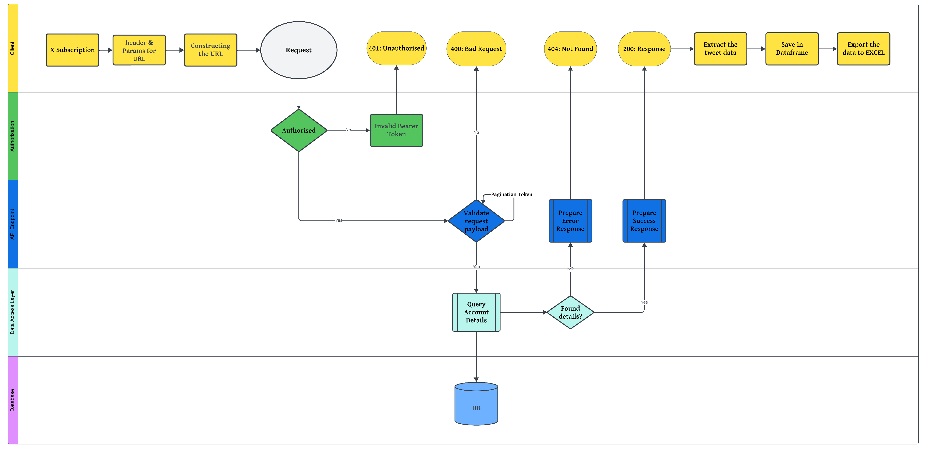
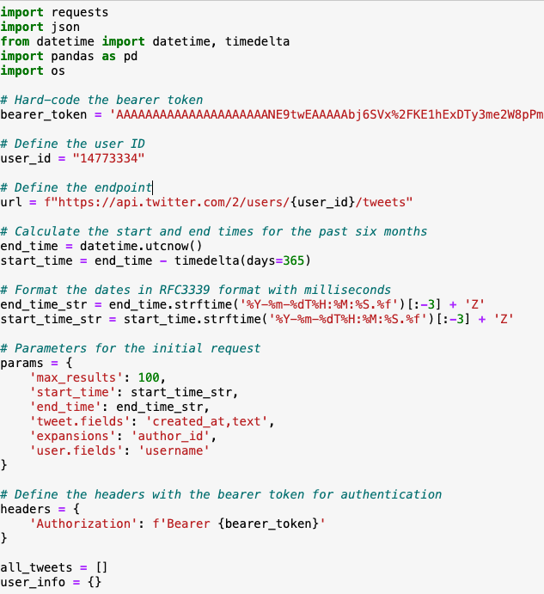
Extracting the Tweets

Slide 5
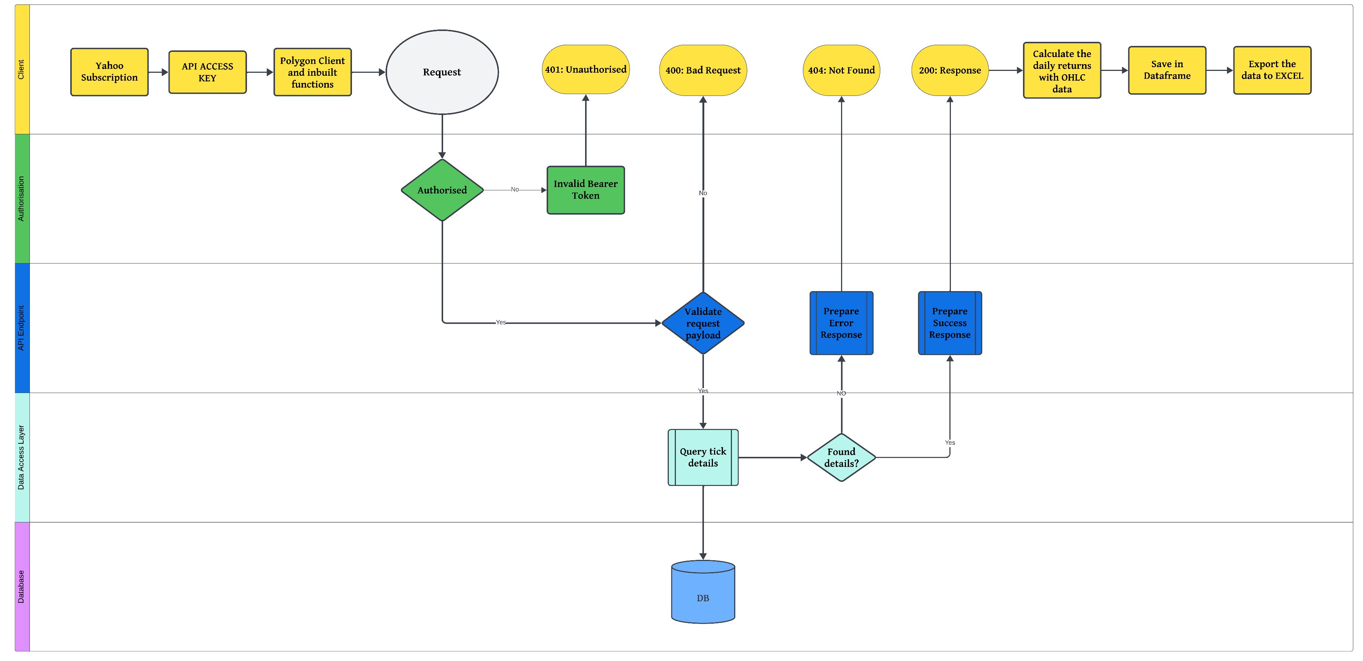
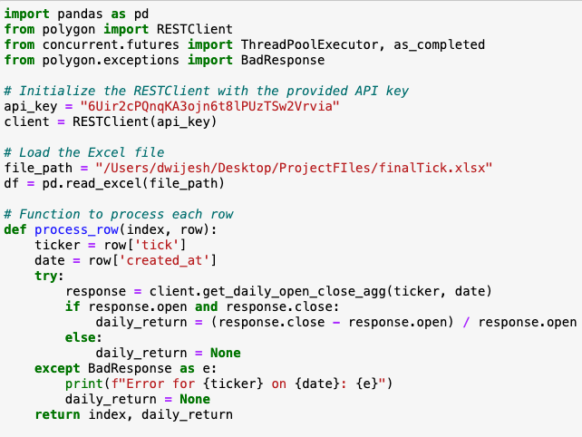
Daily Returns – Yahoo API

Slide 6
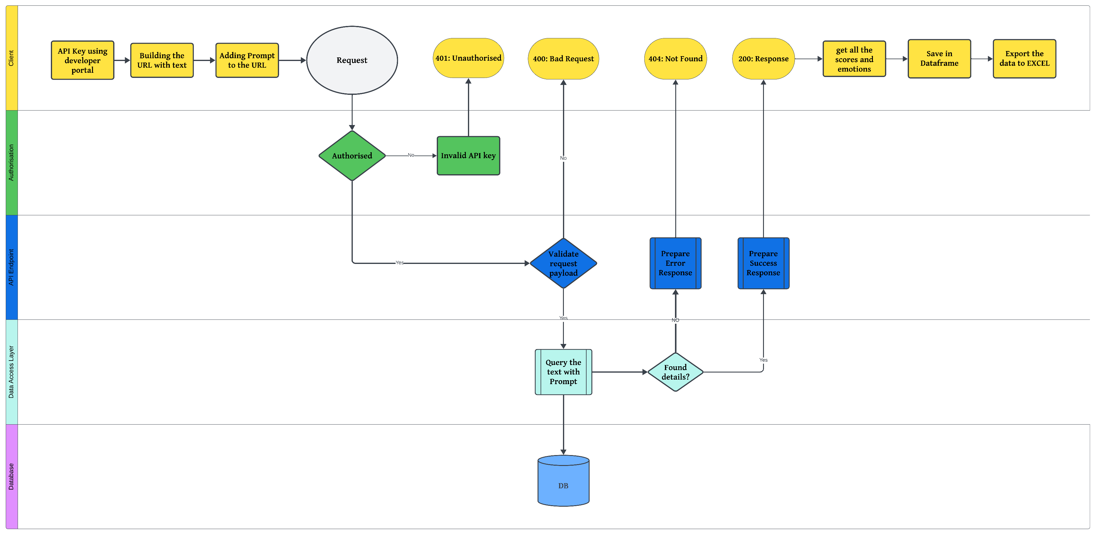
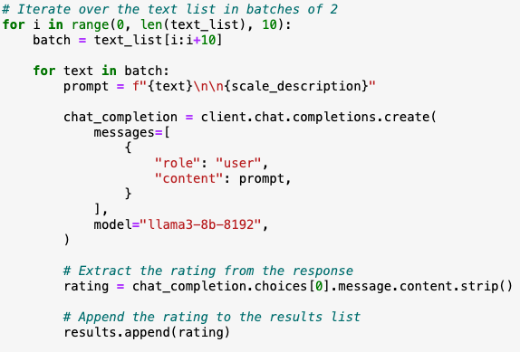
Sentiment Analysis With Groq LLM

Slide 7
Scores Definition
Sentiment Score: Helps gauge the overall sentiment expressed in the CEO's communication using VADER model (Valence aware Dictionary and Sentiment Reasoner)
Intensity Score: Indicates how strongly a sentiment is expressed, which might correlate with the impact of the message.
AI Emphasis Score: Shows how much the CEO focuses on AI topics, potentially reflecting the company’s strategic emphasis on technology.
Emotion: Provides insights into the emotional tone of the CEO's messages, which might influence public perception and market reactions.

Slide 8
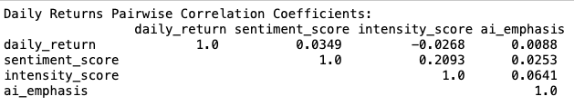
Exploratory Analysis – Pairwise Co-relation
Daily Return & Sentiment Score: Moderate positive correlation.
Daily Return & Intensity Score: Moderate negative correlation.
Daily Return & AI Emphasis: No meaningful relationship.

Slide 9
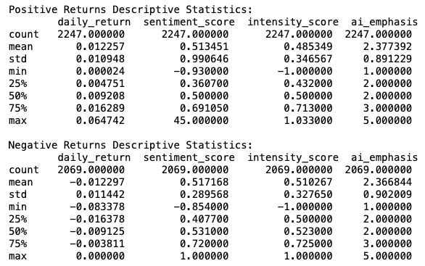
Exploratory Analysis – Summary Statistics
Positive Daily Returns
Mean Daily Return: 0.012, Std: 0.011
Mean Sentiment Score: 0.513, Std: 0.991
Mean Intensity Score: 0.485, Std: 0.347
Mean AI Emphasis: 2.377, Std: 0.891
Negative Daily Returns
Mean Daily Return: -0.012, Std: 0.011
Mean Sentiment Score: 0.517, Std: 0.290
Mean Intensity Score: 0.510, Std: 0.328
Mean AI Emphasis: 2.367, Std: 0.902

Slide 10
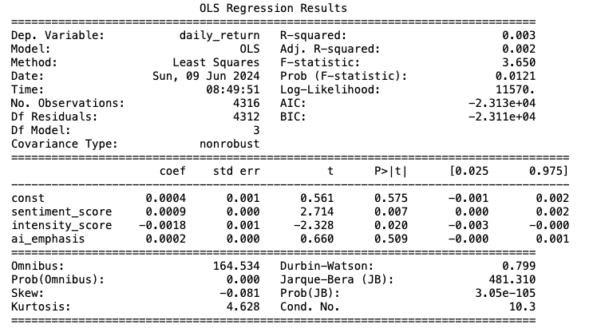
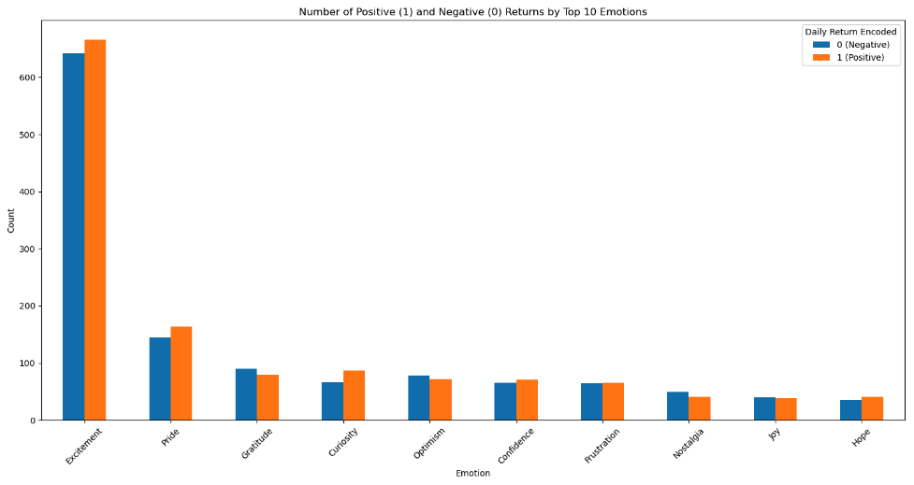
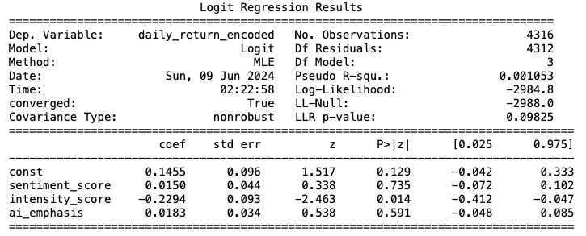
Emotions, Prediction & Classification Models
Sentiment's linear coefficient: 0.0009
Intensity's linear coefficient: -0.00137
Sentiment's logistic coefficient: 0.0103
Intensity's logistic coefficient: -0.236
Notes:
Simple Linear Regression
Dependent Variable: Daily Return Independent Variables: Sentiment Score, Intensity Score, AI Emphasis
Interpretation:
The model explains very little variance in the daily returns (R-squared: 0.003).
Sentiment Score has a small positive effect on daily returns, while Intensity Score has a small negative effect.
AI Emphasis does not have a statistically significant effect on daily returns.
Overall, the model is not very strong in explaining the variations in daily returns.
Logistic Regression
Dependent Variable: Daily Return Encoded Independent Variables: Sentiment Score, Intensity Score, AI Emphasis
Coefficients
The logistic model also explains very little variance in the binary daily return (Pseudo R-squared: 0.001).
Intensity Score has a statistically significant negative effect on the likelihood of a positive daily return.
Sentiment Score and AI Emphasis are not statistically significant in predicting positive daily returns.
The model has limited predictive power, suggesting other factors might be more influential in predicting daily returns.

Slide 11
Limitations
Given adequate resources the scope of analytics can be implemented to a much bigger number of companies and tweets
Pagination Token and rate limitations on X platform is a big obstacle for automation of tweet extraction
Lack of Proper Documentation for endpoint access on X APIs
The LLM takes more time to Process the requests

Slide 12
Learning
From MSIS Coursework
System Analysis and Design helped to build the Processes and decide the use-cases for this Project.
XML and Web services Class helped to build the API’s.
Statistical Computing, gave a complete understanding of Python for Data Analytics and Machine Learning.
Data Mining for Business Intelligence helped me to understand the concepts of text mining and sentiment analysis
Additional Learning from this project
Use APIs to extract information from X and Yahoo Finance with limited/lacking documentation.
USE API access to connect to LLMs for text processing
Leverage Large Language Models for Sentiment Analysis

Slide 13
Conclusion
Prediction Accuracy:
Prediction Model has a lower error in predicting continuous daily returns.
Classification has Better accuracy in predicting binary daily return.
Model Suitability:
Prediction Model: Better suited for predicting actual daily return values.
Classification Model: Useful for understanding likelihood of positive or negative returns, but less effective than linear regression for precise prediction.
Data Insights:
Sentiment: Positively impacts stock performance, though marginally.
Intensity: Generally, more intense sentiments may correlate with negative returns.
AI Emphasis: Slight positive influence on stock returns

Slide 14
References
Groq. (n.d.). The Groq LPU™ Inference Engine, https://wow.groq.com/.
Prompt Engineering. (n.d.). Groq's LPU: Advancing LLM Inference Efficiency. https://promptengineering.org/.
Williams, W. (2024, February 27). 'Feels like magic!': Groq's ultrafast LPU could well be the first LLM-native processor — and its latest demo may well convince Nvidia and AMD to get out their checkbooks. TechRadar, https://www.techradar.com/.
Groq. (n.d.). Why Groq, https://wow.groq.com/why-groq/.
X Developer Platform, https://developer.x.com/en/docs/twitter-api
Yahoo Finance, Polygon.io, https://polygon.io/docs/stocks/getting-started

Slide 15
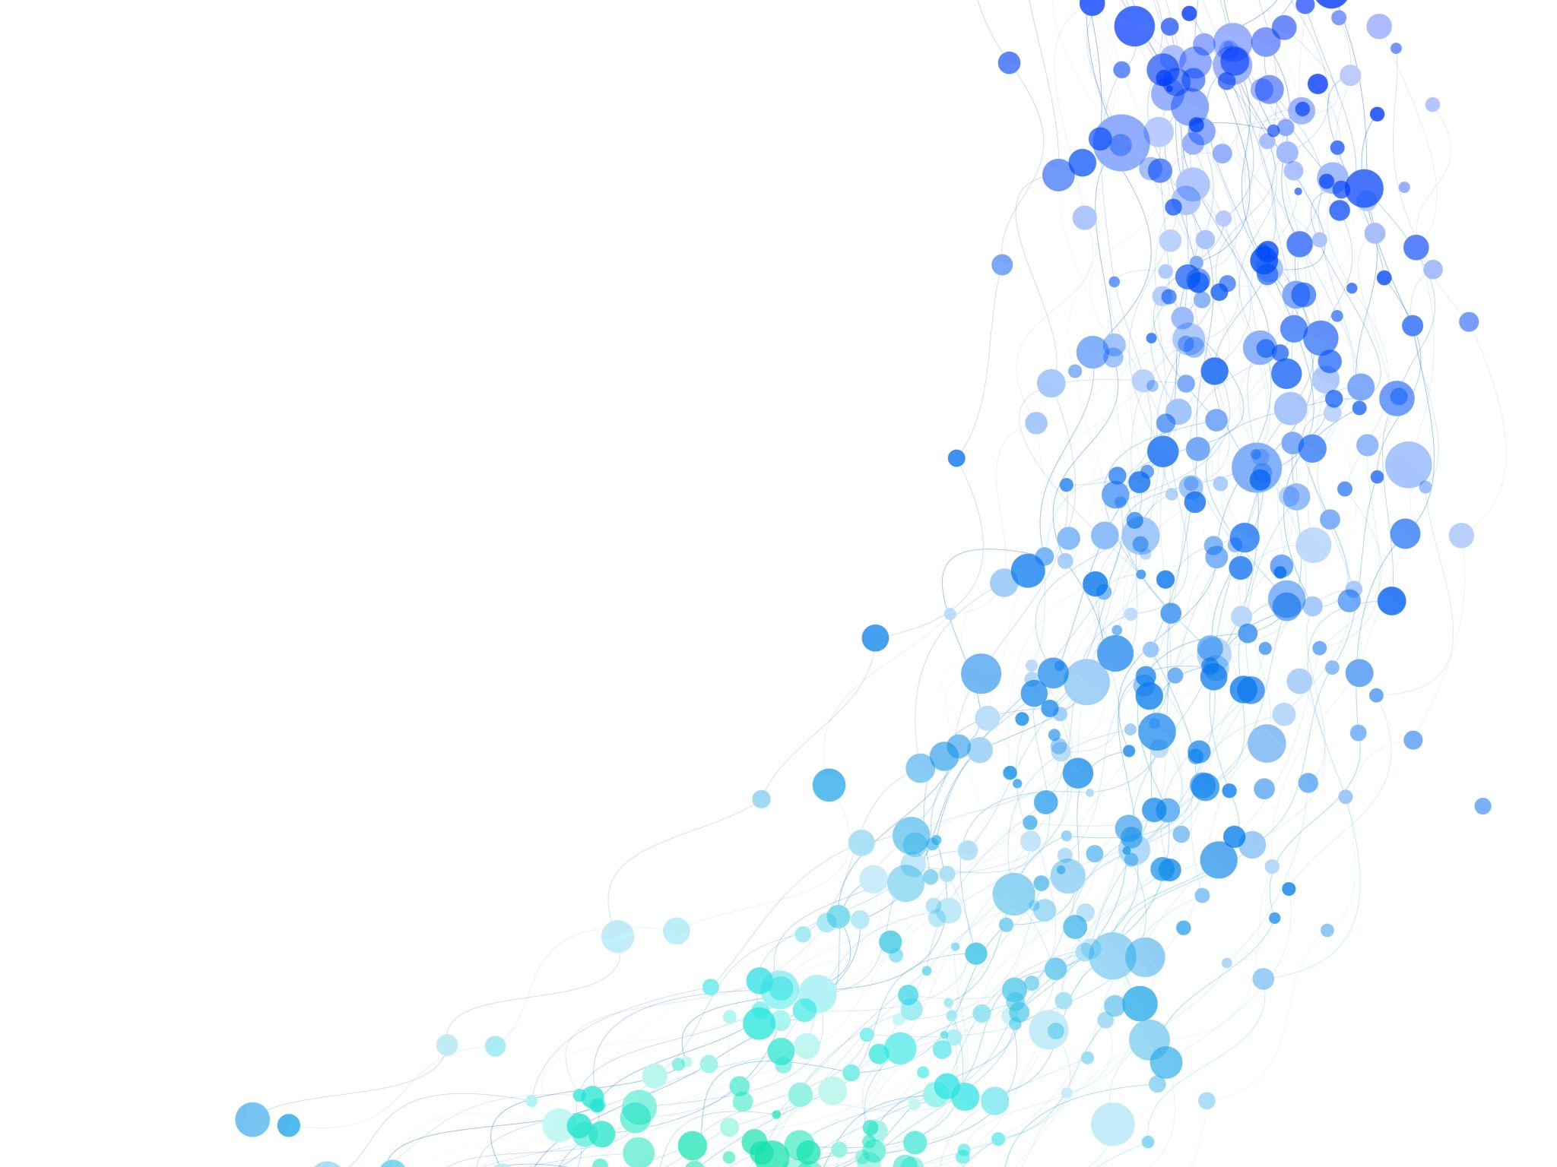
Thank you

